Slide 1

Java Objects
by Alex Joslin

Slide 2
Primitive Values vs objects
public static void func() {
int x = 10;
Vehicle car = new Vehicle();
}
public static void main(String[] args) {
func();
}
stack
heap

Slide 3
Primitive Values vs objects
main()
public static void func() {
int x = 10;
Vehicle car = new Vehicle();
}
public static void main(String[] args) {
func();
}
stack
heap

Slide 4
Primitive Values vs objects
func()
main()
public static void func() {
int x = 10;
Vehicle car = new Vehicle();
}
public static void main(String[] args) {
func();
}
stack
heap

Slide 5
Primitive Values vs objects
func() x=10
main()
public static void func() {
int x = 10;
Vehicle car = new Vehicle();
}
public static void main(String[] args) {
func();
}
stack
heap

Slide 6
Primitive Values vs objects
func() x=10
main()
public static void func() {
int x = 10;
Vehicle car = new Vehicle();
}
public static void main(String[] args) {
func();
}
stack
heap

Slide 7
Primitive Values vs objects
func() x=10 car
main()
public static void func() {
int x = 10;
Vehicle car = new Vehicle();
}
public static void main(String[] args) {
func();
}
stack
heap

Slide 8
Primitive Values vs objects
func() x=10 car=
main()
public static void func() {
int x = 10;
Vehicle car = new Vehicle();
}
public static void main(String[] args) {
func();
}
Vehicle
stack
heap

Slide 9
Primitive Values vs objects
func() x=10 car=
main()
public static void func() {
int x = 10;
Vehicle car = new Vehicle();
}
public static void main(String[] args) {
func();
}
Vehicle
stack
heap

Slide 10
Primitive Values vs objects
main()
public static void func() {
int x = 10;
Vehicle car = new Vehicle();
}
public static void main(String[] args) {
func();
}
Vehicle
stack
heap

Slide 11

Primitive Values vs objects
main()
public static void func() {
int x = 10;
Vehicle car = new Vehicle();
}
public static void main(String[] args) {
func();
}
Vehicle
stack
heap

Slide 12
Primitive Values vs objects
main()
public static void func() {
int x = 10;
Vehicle car = new Vehicle();
}
public static void main(String[] args) {
func();
}
stack
heap

Slide 13
Stack vs heap
Stack | Heap
Static memory allocation | Dynamic memory allocation
Faster memory access | Slower memory access
Meant for items with short life span | Meant for items with longer life span
Each thread has 1 stack, and they can’t share items in their stack with other threads | Threads can share access to items within the heap.
Short memory size | Large memory size
Memory allocated at compile time | Memory allocated at run time

Slide 14
NOte
Vehicle car = new Vehicle();

Slide 15
NOte
Vehicle car = new Vehicle();
String str = new String(“hello”);

Slide 16
NOte
Vehicle car = new Vehicle();
String str = new String(“hello”);
String str2 = “bye”;
?

Slide 17
NOte
Vehicle car = new Vehicle();
String str = new String(“hello”);
String str2 = “bye”;
?
or
stack
heap

Slide 18
NOte
String Constant Pool
Vehicle car = new Vehicle();
String str = new String(“hello”);
String str2 = “bye”;
String
“bye”
Vehicle
String
“hello”
heap

Slide 19
NOte
String Constant Pool
Vehicle car = new Vehicle();
String str = new String(“hello”);
String str2 = “bye”;
String str3 = “bye”;
String
“bye”
Vehicle
String
“hello”
heap

Slide 20
NOte
String Constant Pool
Vehicle car = new Vehicle();
String str = new String(“hello”);
String str2 = “bye”;
String str3 = “bye”;
String
“bye”
Strings are "special" objects in Java.
Java designers decided that Strings
are used so often that they needed their
own syntax as well as a caching strategy.
Two stings equal to the same literal will point
to the same location in memory instead of creating
new objects. This saves time and memory.
Vehicle
String
“hello”
heap

Slide 21
NOte
String Constant Pool
String str0 = new String(“hello”); String str1 = new String(“hello”);
String str2 = “bye”;
String str3 = “bye”;
String
“bye”
String
“hello”
String
“hello”
heap

Slide 22
NOte
String Constant Pool
String str0 = new String(“hello”); String str1 = new String(“hello”);
String str2 = “bye”;
String str3 = “bye”;
// str0 == str1 ->False
// str2 == str3 ->True
String
“bye”
String
“hello”
String
“hello”
heap

Slide 23
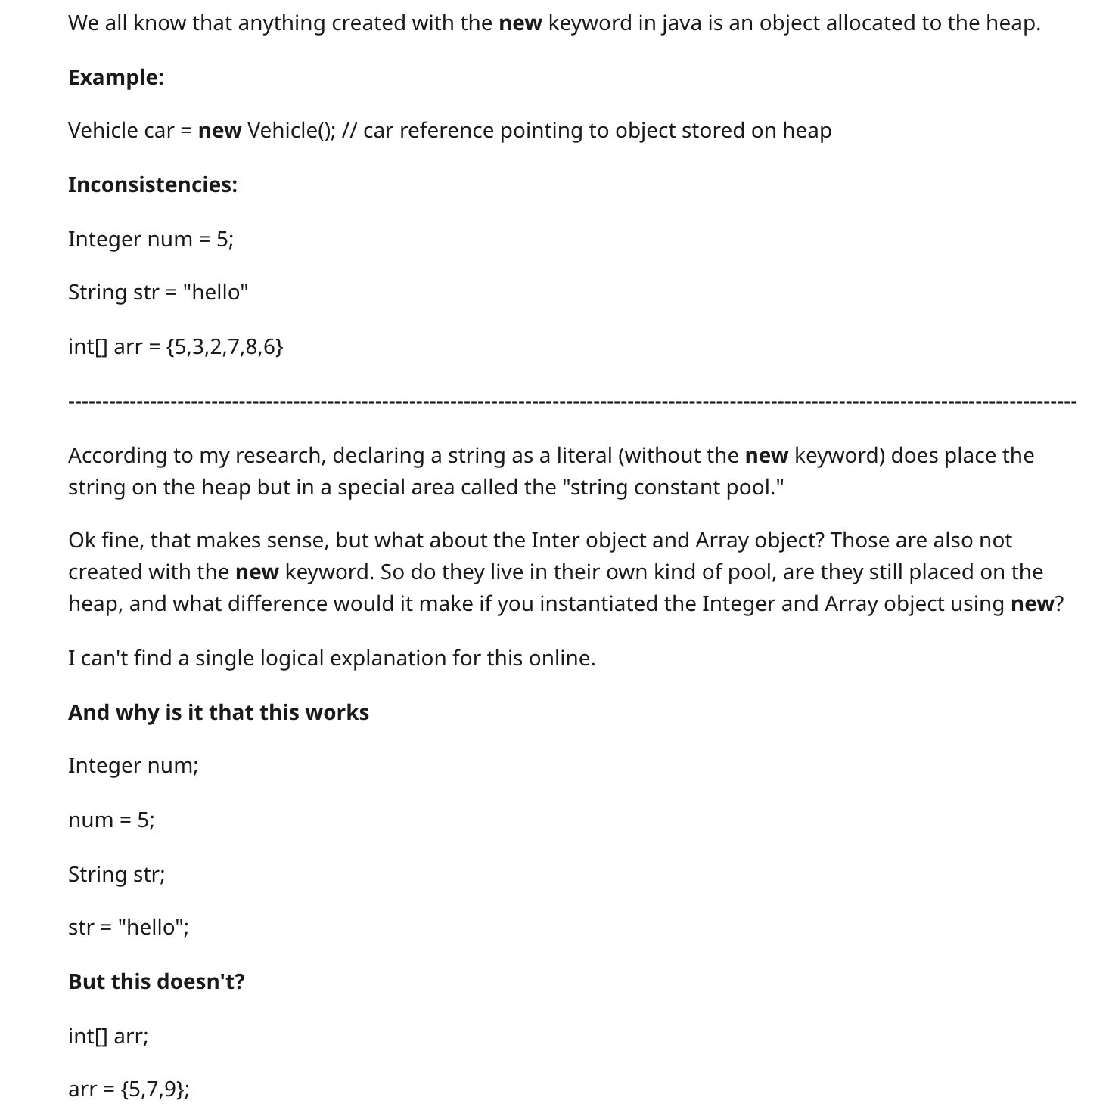
Inconsistencies In Java

Slide 24
Possible Explanations
Syntactic Sugar equivalent to
int[] arr = new int[] {5,3,2,7,8};
Java needs to know length of array and can infer that from
int[] arr = {5,7,9};

